Slide 1
Deductive vs. Inductive
Reasoning
Notes:
Why science doesn’t prove things but rather tries to increase the probability that a something is true

Slide 2
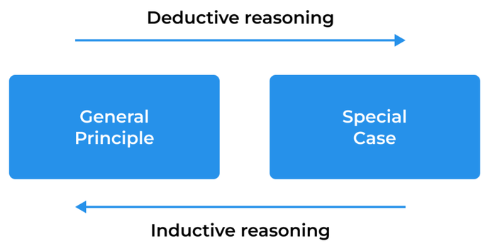

Slide 3
Deductive Reasoning
Starts with one or more general rules or premises and ends with a conclusion. If the general rules or premises are true than the conclusion must be true.
Ex. All dogs have four legs. My pet is a dog. Therefore, my pet has four legs.
Premise 1
Premise 2
Conclusion
Note that the conclusion can only be false if one of the two premises is false.

Slide 4
Inductive Reasoning
Start with some evidence, data, observations, etc. and come up with a general rule to explain the evidence. The general rule is not necessarily guaranteed to be true.
Ex. The sun has always risen. Therefore, the sun will rise tomorrow.
Evidence/ Observations
Conclusion
Notice that this assumes that the past predicts the future and so because the past does not necessarily always predict the future the conclusion is not guaranteed to be true, but is only probabilistically true based on past experience.

Slide 5
IR or DR?
All dolphins are mammals. All mammals have kidneys. Dolphins have kidneys.
  Deductive
Every time I drop an apple it falls to the ground. All apples that are dropped will fall to the ground.
  Inductive
Chimps and humans share 99% of their genetic material. Chimps and humans evolved from a common ancestor.
  Inductive
All antibiotics kill bacteria. Penicillin is an antibiotic. Therefore penicillin kills bacteria
  Deductive
Given this number sequence: 5, 8, 11, 14, 17, __. The next number is 20.
  Inductive

Slide 6
Inductive Reasoning in Science
Unlike math or logic, science is not a deductive process, it is an inductive one
Science does not prove things, but rather tries to identify patterns from observations of the natural world and come up with general theories that are probably true
  Scientific experiments help us gather data to see if these patterns continue to hold true
  The more data we gather that supports or fits the pattern/theory, the more the probability increases of the theory being true
  But it is never 100% guaranteed to be true in a deductive sense, for example:
    New data can be gathered that goes against the pattern and would reduce the probability that the theory is true
    Someone can look at the existing evidence and come up with a pattern or theory that better explains the data

